Slide 1


It Smells Like Green Spirit
By Daira Consuegra Huertas

Slide 2



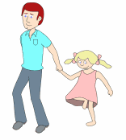

OBJECTIVE
Infers the causes and effects of recycling in our environment through the presentation of a video in which the students will be able to elaborate a Word Album to promote a healthier place to live due to the fact that nowadays the Earth is suffering a lot of irreversible damage.

Slide 3
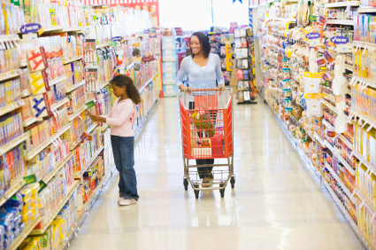
LEARNING SITUATION
Sarah goes to the supermarket with her mother. On the magazine shelves of the store, she sees an album called “Save the Earth, Recycle”

Slide 4
She tells her mother to buy her the album. At home they both start pasting the first pictures about saving the earth through recycling, while they wonder…

Slide 5
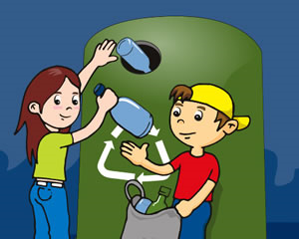
GENERATOR QUESTION
What activities could we develop to promote Recycling?

Slide 6

GUIDE QUESTIONS
How can Recycling help us save our Planet Earth?

Slide 7

MAIN PRODUCT
Word Album about Recycling

Slide 8
LEARNING ACTIVITIES
He/She
Talks about the concept of Recycling and ways of developing it.
Watches a video about Recycling.
Recognizes the way materials are separated to develop recycling.
Listens to the general indications of the album.

Slide 9
Searches for information in the internet.
Finds recycling products labels.
Makes an album in Word.
Develops a general discussion about the topic.

Slide 10
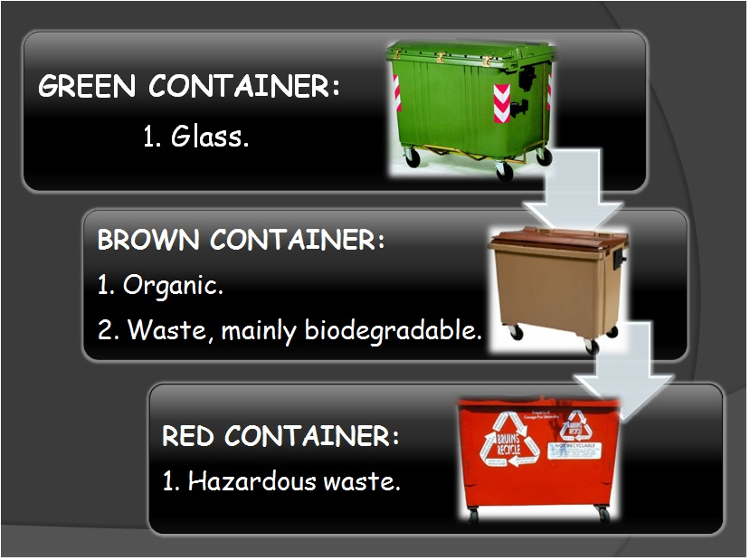

Slide 11
CRITERIA RUBRIC
Criteria for Evaluating an Album in Word
 | 4 | 3 | 2 | 1 | TOTAL POINTS
Contents | Project contains all the required elements. | Project contains most of the required elements. | Project contains only a few of the required elements. | Project does not contain any of the required elements.
Neatness | Work is neat throughout the entire project. | Work is neat throughout most of the project | Work is somewhat difficult to read. | Work is very difficult to read.
Organization | Project is very well organized. | Project is mostly well organized. | Project is somewhat unorganized. | Project is unorganized.
Attractiveness | The project is exceptionally attractive and visually appealing to the reader. | The project is mostly attractive and visually appealing. | The project is somewhat attractive but can be visually distracting | The project is not appealing to the reader’s attention.
Originality | Project is presented in the students own voice | Project is presented mostly in the students own voice. | Project lacks originality | Project has no creativity at all.
On Time | Project is complete and turned in on the due date. | Project is complete and turned in 1 day late. | Project is complete and turned in 2 days late. | Project is Incomplete and turned in later than 2 days past the due date.

Slide 12
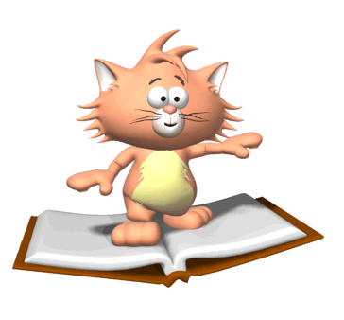
REFERENCES

Slide 13

SCAFFOLDING TOOLS
VIDEO

Slide 14
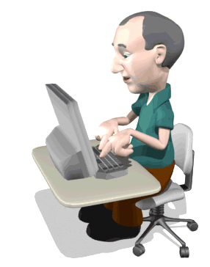
Information
http://www.recycling-guide.org.uk/
http://www.webschool.org.uk/webworld/roperr.html
http://www.bbc.co.uk/schools/barnabybear/games/recycle.shtml

Slide 15
IMAGE CREDITS
http://2.bp.blogspot.com/_KpB5CryuhN4/S8zy_gapUsI/AAAAAAAAAK8/6K9DXNE7Sc8/s1600/simbolo-y-mundo.jpg
http://www.ecopilos.com/wp-content/uploads/2009/10/reciclaje22.jpg
http://trialx.com/curetalk/wp-content/blogs.dir/7/files/2011/05/diseases/Children-3.jpg
http://www.awesomebackgrounds.com/templates/powerpoint-timer.GIF
http://www.graphics18.com/wp-content/uploads/2009/05/482192tmyx3z7juf.gif

Slide 16

PROGRAM AREA
Subject: English
Areas:
LISTENING, SPEAKING, READING, WRITING.

Slide 17
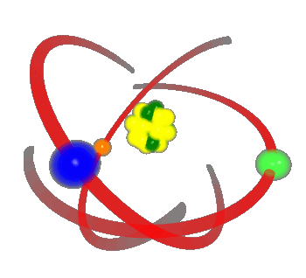
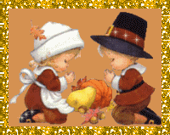

RELATED SUBJECTS
SCIENCE
AGRICULTURE
ARTS

Slide 18
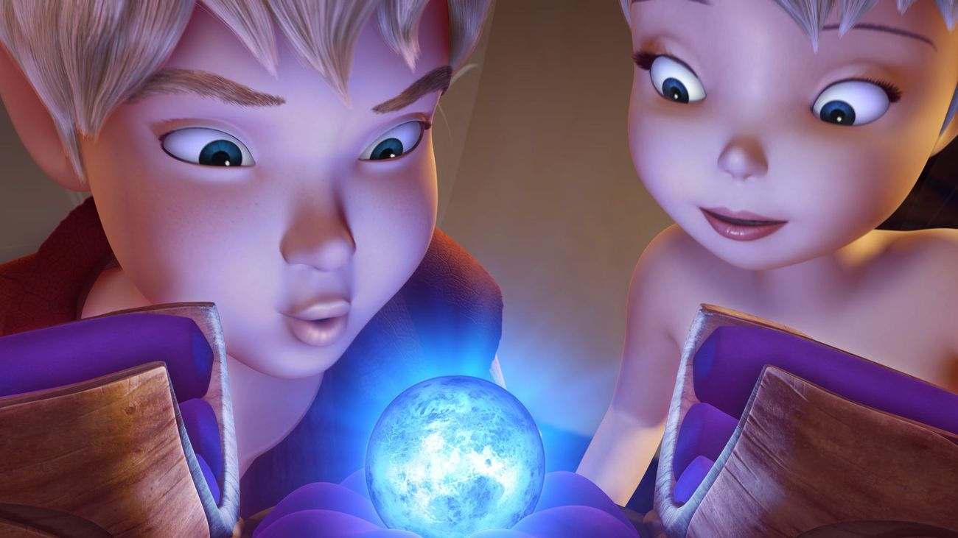

TIME
3 hours of 40 minutes.

Slide 19


Slide 20


